Slide 1
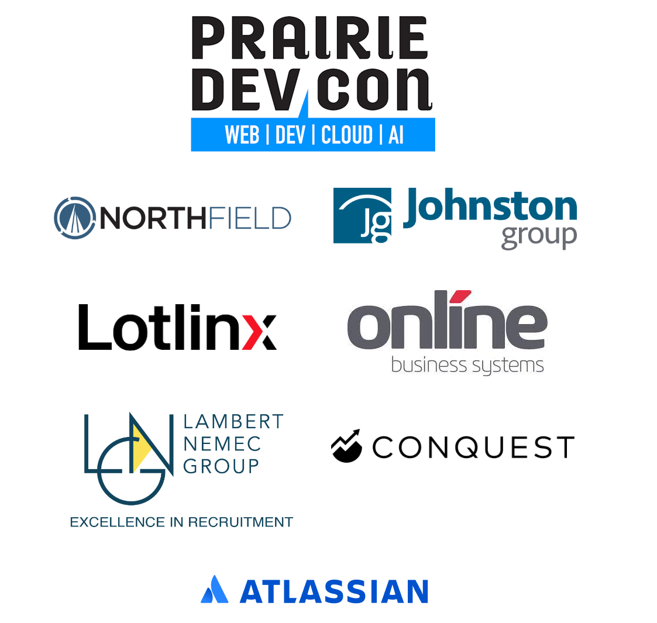
Domain-Driven Design, Ontologically

Slide 2
DDD Ontologically
Peter Ritchie
Prairie DevCon (PrDC) Winnipeg 2024

Slide 3
Challenges

Slide 4
Sound Familiar?
No one person seems can give you the necessary detail for a complete design or implementation
Have you discovered business rules only in the context of an entity when asking “what does this entity need to do?”
You sometimes need to present the domain back to domain experts at a higher level to address contradictions
Eliciting detail on how the domain works from the experts seems much harder than it should be
Notes:
As a dev is isn’t a domain expert trying to understand a domain, Let me know if these things sound familiar?

Slide 5
Welcome!
Peter Ritchie
Speaker, Blogger, Author, Open-Source Contributor
3 decades of delivering software
Thirteen-time Microsoft MVP, developer technologies
Independent Consultant
Have worked with dozens of clients, across multiple verticals

Slide 6
Doman-Driven Design, Ontologically?
A Domain’s Ubiquitous Language doesn’t include DDD terms
Ontologies are a broader, more established practice
Discovered that the language of ontologies was helpful communicating with domain experts
A well-established science to categorize and partition knowledge and perception
Notes:
Since utilizing ontological thinking when analyzing, modeling, and communicating domain models I’ve come across others research into area. Scientific papers; some very mathematical, some similar, but all seemed to focus more on ontology and less on domain modeling.
What I hope you get out of this session is how to ask questions about the domain.

Slide 7
Doman-Driven Design, Ontologically
Can ease communication
Provides broader, established, higher-level language
Provides categorizations based on reality
Provides expectations that can make missing information more apparent
Promotes deeper insight by providing areas to question
Provides blanks so you can fill in the blanks
Notes:
Based on reality, philosophically speaking. Ontology is rooted in philosophy and easily driven by different priorities and opinions

Slide 8
DDD Review

Slide 9
Domain-Driven Design – A Review
Ubiquitous Language: unequivocal language of the domain
Domain Objects: Entities, Value Objects
Aggregates: maintaining consistency amongst related objects
Domain Events: communicating intra-domain occurrences
Bounded Context: independent subset of rules, language, and semantics
Layered Architecture: partitioning implementation by level of abstraction and cohesiveness (or lack thereof)
Service: realization of use-case and business function
Notes:
Aggregate: a group of domain objects that participate in a consistency boundary.

Slide 10
Ontologies Intro

Slide 11
Ontology Components
Classifications: Subsumption hierarchy (is-a, sub/super)
Individuals/instances: Manifestations of classes
Characteristics: aspects, features of individuals
Attributes: Manifestations of characteristics
Relationships: By class, composition, activity
Axioms: Assertions, restrictions (rules)
Actions/Events: What can be done, has been done
Notes:
Ontological components are established techniques for establishing a thorough understanding of a body of knowledge or reality
With a broader understanding of what complete knowledge or understanding looks like, you can see the blanks and ask the questions to fill in the blanks.
Ontology can introduce dimensions that when overlayed with domain knowledge can expose gaps.

Slide 12
Classifications and Hierarchy

Slide 13
Taxonomy
A subsumption hierarchy
A tree of is-a-subclass, is-a-superclass relationships
Comparable to object-oriented models
Aligns nicely with OOAD, DDD
Notes:
Not comparable to entity diagrams or relational diagrams, which detail composition

Slide 14
Continuants and Continuums

Slide 15
Continuant
Exists in a continuum, in various states across time
Has Identity, same thing despite some changing attributes
Various states in response to Actions
Change to state observable as Events
Not just a bag of properties with one being an ID
Philosophically akin to Aggregates

Slide 16
Characteristics, Attributes and Consistency

Slide 17
Characteristics, Continuum and Consistency
Attributes change semantically
Individuals maintain consistency throughout continuum
Axioms help define consistency
Subset of characteristics may help define the classification
Certain attributes help establish an identity
Notes:
Individual are not defined by a number or GUId in an ontology.

Slide 18
Entities: Actors and Things Acted Upon

Slide 19
Remember Object-Orientation
Object encapsulate state and model behavior
Some objects are acted upon
Some objects are actors and act upon others
Don’t force behavior on individual domain objects that isn’t natural
Notes:
One thing that may get lost thinking purely ontologically is behavior and actions. Actions can appear as relationships

Slide 20
Filling in the Blanks

Slide 21
Leveraging Thinking Ontologically

Slide 22
Fill in the Blanks - Aggregate Continuum
State Change | Action, Event? | Use Case? | Axioms, Rules? | Actors?
Create | ? | ? | ? | ?
Update | ? | ? | ? | ?
Update | ? | ? | ? | ?
Destroy | ? | ? | ? | ?
Notes:
Given a bag of properties, the lowest common denominator is to change a property or two—otherwise known as a state change. We can gain deeper insight into the domain by filling in the blanks in situations where we know we need to change properties to avoid missing the semantics. For a property change, we can ask for domain terminology around the action, event, use case.

Slide 23
Fill in the Blanks - Aggregate Continuum
State Change | Action, Event? | Use Case? | Axioms, Rules? | Actors?
Create | ? | ? | ? | ?
Correct Address | Support | Incorrect Address | ? | ?
Move | Moved | Move | ? | ?
Destroy | ? | ? | ? | ?
Notes:
I put Actors on the end because I’ve found that the source of a state change is only unclear when dealing with some back-end systems. But, if there’s no granularity in type of actor, it probably warrants a question.

Slide 24

Fill in the Blanks - Aggregate Continuum
State Change | Action, Event? | Use Case? | Axioms, Rules? | Actors?
Create | ? | ? | ? | User
Correct Address | Support | Incorrect Address | ? | User
Move | Moved | Move | ? | User
Destroy | ? | ? | ? | User
?

Slide 25
Reveal more Pivoting Dimensions

Slide 26
Fill in the Blanks - Aggregate Continuum
Use Case | Action, Event? | States? | Axioms, Rules? | Actors?
Case 1 | ? | ? | ? | ?
Case 2 | ? | ? | ? | ?
Case 3 | ? | ? | ? | ?
Case 4 | ? | ? | ? | ?

Slide 27
Scope Ontologicalness
Use ontological components to gain deeper insight
Notes:
Remember we want to thing ontologically to gain deeper insight into an existing domain.

Slide 28
Scope Ontologicalness
Use ontological components to gain deeper insight
Avoid creating an actual ontology
Notes:
If the domain and business cannot accept higher granularity, don’t force it. We’re not creating a full-blown ontology.

Slide 29
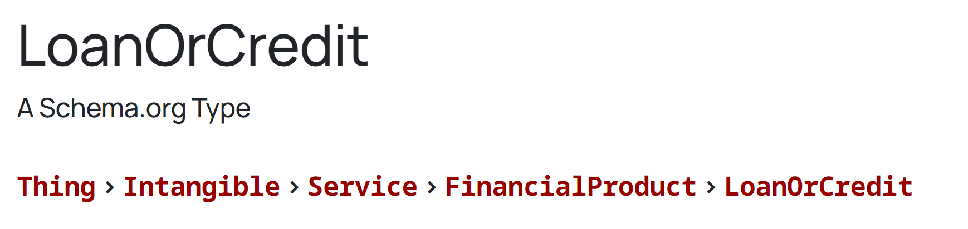
Scope Ontologicalness
Use ontological components to gain deeper insight
Avoid creating an actual ontology
Limit classification hierarchy to two or three levels

Slide 30
Scope Ontologicalness
Use ontological components to gain deeper insight
Avoid creating an actual ontology
Limit classification hierarchy to two or three levels
Scope to domain/business language

Slide 31
Scope Ontologicalness
Use ontological components to gain deeper insight
Avoid creating an actual ontology
Limit classification hierarchy to two or three levels
Scope to domain/business language
Focus on the known, or what can be known
Notes:
Avoid what if and just in case, limit to what the domain can assert as correct

Slide 32
Scope Ontologicalness
Use ontological components to gain deeper insight
Avoid creating an actual ontology
Limit classification hierarchy to two or three levels
Scope to domain/business language
Focus on the known, or what can be known
Avoid “what if” and “just in case” design choices
Notes:
If the domain and business cannot accept higher granularity, don’t force it.
Avoid what if and just in case, limit to what the domain can assert as correct

Slide 33
Scope Ontologicalness
Use ontological components to gain deeper insight
Avoid creating an actual ontology
Limit classification hierarchy to two or three levels
Scope to domain/business language
Focus on the known, or what can be known
Avoid “what if” and “just in case” design choices
Limit to what the domain can provide measures for (acceptance criteria)
Notes:
If the domain and business cannot accept higher granularity, don’t force it.
Avoid what if and just in case, limit to what the domain can assert as correct

Slide 34
Mapping to Domain Objects
Attributes
Continuants
Continuums
Relationships
Relationships
Axioms
Value Objects
Entities and Aggregates
States/Classifications
Actions
Specializations
Services (rules)

Slide 35
Mapping to Domain Objects
Attributes
→ Value Objects
Continuants
→ Entities and Aggregates
Continuums
→ States/Classifications
Relationships
→ Actions
Relationships
→ Specializations
Relationships
→ Compositions
Axioms
→ Services/Specifications
Notes:
Application services are primarily orchestrations that orchestrate domain objects in the context of rules

Slide 36
Recognize Design Principles
Recognize an analysis “stage”
Make the implicit explicit
Isolate responsibilities (SRP)
Open for extension (implement classifications/relationships: OCP)
Design the domain’s semantics (Does what it says it will do: LSP and ISP)
Recognize and isolate higher-level concepts from lower-level concepts (Hierarchy: DIP)

Slide 37
Design Tidbits
Shift-left design
Avoid Big Design Up Front
Avoid shallow design
Differentiate between actor entities and acted upon entities
Recognize use-cases as orchestrations
Recognize application and domain orchestrations as services
Notes:
Shift design left, design knowns as soon as possible.
Avoid shallow design: two or three levels of classifications, recognize primitive obsession.

Slide 38
Caveats

Slide 39
Caveats
Ontologies are a branch of philosophy
Several branches of ontologies and theories
Many opinions on the correct ontology
Ontologies exist for the sake of ontologies
Potential source of philosophical discussions
Picking terms from multiple branches is confusing
Notes:
It’s easy to get philosophical and not gain insight where it’s useful.
Avoid getting caught up in the differences in varying branches, find what’s useful for you or your team and scope to that.

Slide 40
Takeaways
Multi-level classifications help differentiate concepts
Different concepts have unique ontological features
Unique lifecycle states
Unique actions and events that relate to them
Ontological thinking provides template of the structure of knowledge and perception
Easier to find what’s missing and fill-in-the-blanks

Slide 41




Peter Ritchie
@peteraritchie
/in/peteraritchie
peteraritchie
peter@peterritchie.com

